Slide 1
Cuisine filtering Application
Group 12 – Professor Robert Hierons
Notes:
1

Slide 2
Introduction
Filtering different cuisines, depending upon customers preference.
So for example; "Person A wants Pasta, in Uxbridge"
The application searches for that and locates all the possible restaurants in Uxbridge with that specific dish in their menu
The food places will be filtered accordingly to what “Person A” wants to see
Which can be by, ratings, cost, distance, preferences etc

Slide 3
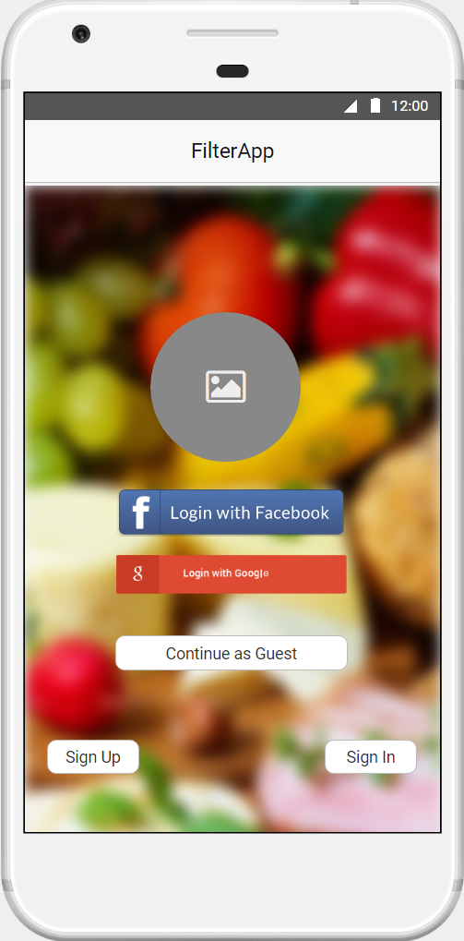
Requirements
Database with all the restaurants in Uxbridge.
Filter food according to popular requirements such as: • The average price per meal
• The star rating of the restaurant
• The star rating of the restaurant
• The type of cuisine
• Special offers on the day e.g. (Special offer times, student discount, meal deals)
Random generator once you have chosen your requirements
Avigation feature - informs the distance from a few popular places
Notes:
Requirements for our app include:
First and foremost there needs to be a database with all the restaurants in Uxbridge.
This app will need to filter food according to popular requirements such as:
the average price per meal
the star rating of the restaurant
the type of cuisine
special offers on the day e.g. (Special offer times, student discount, meal deals)
Random generator once you have chosen your requirements, so the app chooses a cuisine for you.
This app will also need a navigation feature which will tells you the distance from a few popular places, such as Brunel University and Uxbridge station.
The app will then redirect you to the website of the specific restaurant where you can then place your order, such as Just Eat or Hungry House
Lastly the app should be simple and easy to use, with good interface and easy navigation buttons.
3

Slide 4
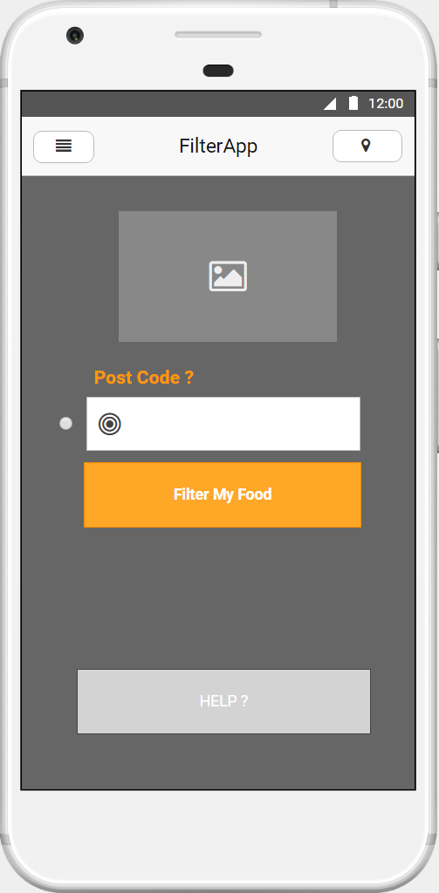
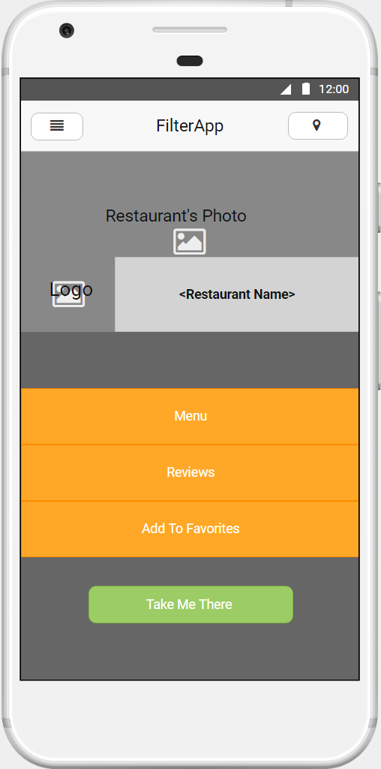
The UI/ Prototype

Slide 5
Solutions for problems
Investigate
Explore
Implement
Identifying and diagnosing the problem
Generating alternative solutions (more than one)
Evaluation of alternatives
Select the best alternative
Implementing the chosen decision
Alternative
Selection
Notes:
Complexity : the application may become complex as developing
Alternative: If plan A doesn’t work out fall back on plan B. There may be various alternatives, each with its own set of uncertainties and consequences.
Changes: Many of the facts may be unknown. Therefore, changes may be required during the development process.
Create a constructive environment.
Investigate the situation in detail.
Generate good alternatives.
Explore your options.
Select the best solution.
Evaluate your plan.
Communicate your decision, and take action.
5

Slide 6
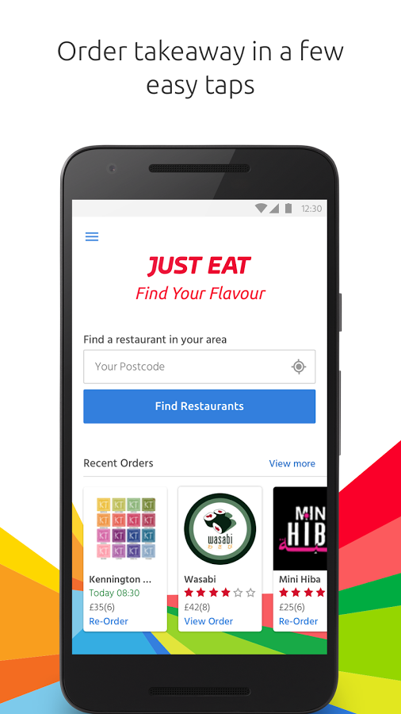
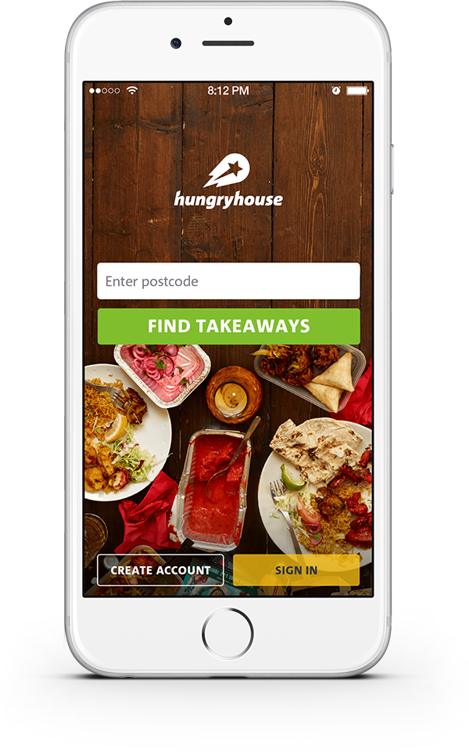
Market Analysis
Target Audience: 15 - 60 year olds and anyone with a smartphone within specific location(Uxbridge)
Competitors: Just EAT, Hungry House, Open Table, Urban spoon, Yelp
What competitor do well: Wide range of food, delivery, customer loyalty, easy UI, they are online
Customers preference: special deals, offers
Aims: - 100-300 Users to use the app as it grows
• Unique features; select restaurants which offer delivery
• Have customers leave feedback, by questionnaires
Notes:
Target Audience:
- Who: Anyone with a smartphone within specific location(Uxbridge) for time being
- Age group: No age group as food is for everyone
-Any specific needs: no needs as options will be available for them. E.g. ‘Veggie’
Competitive Analysis:
- Any consequences of entering market? Few competitors and they have good customer loyalty so it could be difficult to get users to use our application.
- How many competitors are there? JustEAT, HungryHouse, OpenTable, Urbanspoon, Yelp (http://appadvice.com/appguides/show/best-restaurant-finders)
-What does your competitor do well? Wide range of food, delivery, customer loyalty, easy UI, they’re online
Market Trends
What is the thing that the customers like? Customers like special deals, offers that are made available to them. (Can do a questionnaire to find this out)
• Aim to have 100-300 Users to use the app as it grows.
• Tell people in our university about the app, sharing the app on Facebook and twitter
• Attractive and appealing design of the app.
• Unique features like being able to select restaurants which offer delivery
• Have customers leave feedback, by questionnaires
• Target audience 15 - 60 year olds.
• Location: Uxbridge
Barriers to entry:
Competitors well established, e.g Just eat established in 2001, Hungry House established in 2006 therefore they been in the market for a long time.
Some restaurants/fast food places have their own apps.
6

